Slide 1

Brynia-GO-GWYRDD
Ymgyrch
Mawrth - Gorffennaf

Slide 2
Brynia-GO-GWYRDD
Beth- Ymgyrch/Prosiect i helpu Ysgol Bryniago i gwella buarth Bryniago Mawr a Bach gyda planygion a coed ac i ailgylchu- I fod yn fwy Gwyrdd!
Pam- I godi arian i gael Planhygion, Coed, blodau o gwmpas yr Ysgol er mwyn ir Ysgol edrych fwy lliwgar. Bydd y plant yn dysgu a edrych arol y planhygion, ac hefyd er mwyn atal newid hinsawdd.
Pryd- Lawnsio diwedd Mis Mawrth, ac yn gorffen diwedd y tymor yn Gorffennaf.

Slide 3
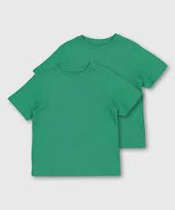
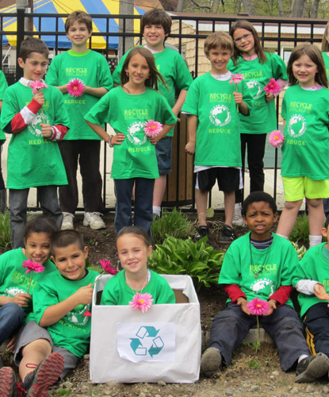

Diwrnod Lawnsio
Gwisg Gwyrdd- plant yn gwisgo dillad gwyrdd ar y dydd
Fideo- plant ar y buarth yn dweud “Brynia-go-gwydd” a rhai o plant or Cyngor Eco yn dweud beth yw’r ymgyrch amdano.

Slide 4



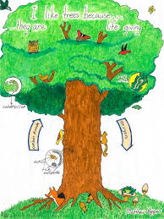




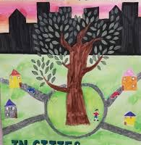
Cystadleuaeth
Poster/Banner ‘Brynia-GO-GWYRDD- plant i greu logo /Poster bydd yn cael eu ddodi ar Tudalen ymgyrch

Slide 5



Cystadleuaeth
Plant i ddylunio poster/baner-
Bydd hyn yn cael ei ddefnyddio ar Tudalen Ymgyrch 'Give as you live' a'r Botwm Cyfrannu/ QR Cod ar gyfer teuluoedd, ffrindiau, busnesau i'w rhoi drwy'r cyfryngau cymdeithasol.
Baner ar gatiau'r ysgol i hyrwyddo'r ymgyrch.
https://donate.giveasyoulive.com/campaign/eafa-oscaronsite-skydive

Slide 6

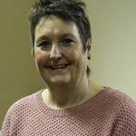
Ymweld â Chi
Gallwn ddod â’n gweledigaeth atoch chi. Byddwn yn falch o gael rhannu’r neges am gysylltu pobl â’r amgylchedd naturiol, a dysgu ar gyfer cynaliadwyedd
Addysg
Adran Addysg
01558 667150

Slide 7




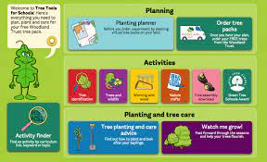
http://www.treetoolsforschools.org.uk

Slide 8

Pob cartref yng Nghymru i gael coeden am ddim i'w phlannu fel rhan o ymrwymiad Llywodraeth Cymru i fynd i'r afael â newid hinsawdd
Llywodraeth Cymru wedi ffurfio partneriaeth â Coed Cadw (Woodlands Trust) i roi ymgyrch ar waith a fydd yn rhoi cyfle i bob cartref yng Nghymru blannu coeden am ddim yng Nghymru.

Slide 9
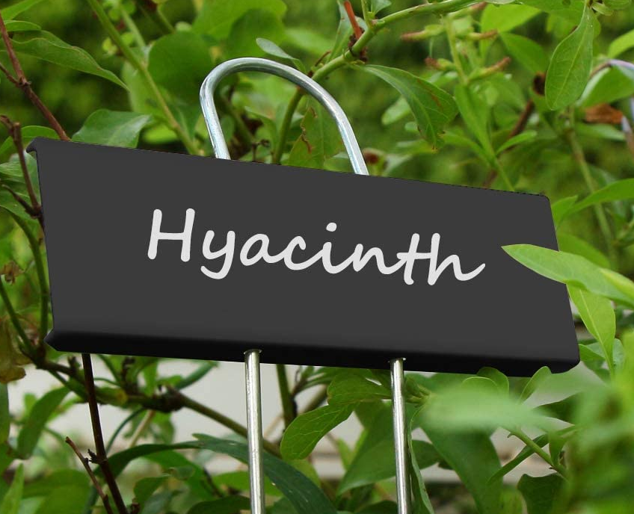
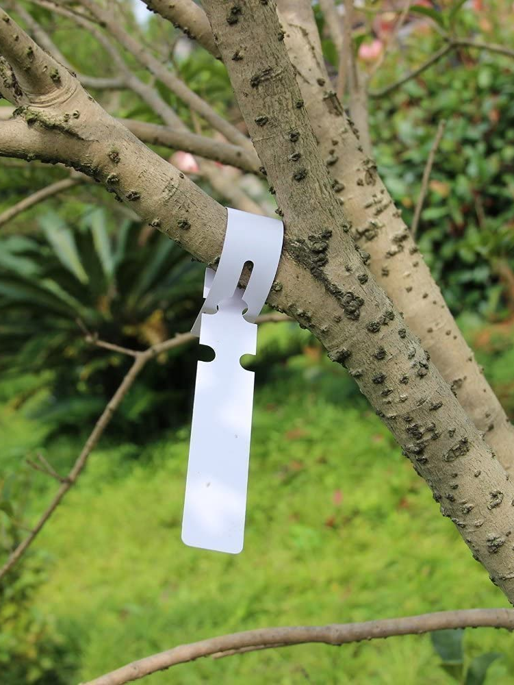
Slide 1
Coeden Dosbarth
Plant y dosbarth i enwi’r goeden.
Enw dosbrath ar pob coeden.
£2.50 wrth pob plenty i prynnu coeden I’r dosbarth

Slide 10
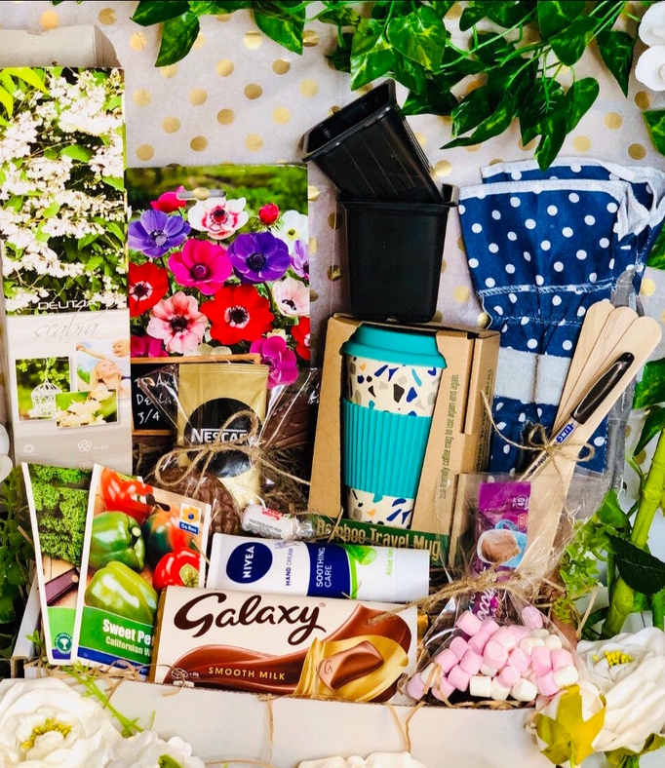
Hamperi
Gwanwyn
Dosbarth
Talu ar Squid- £1 tocyn Eitemau ar gyfer y hamper i fod mewn erbyn ebrill 1af.
Raffl i’w dynnu dydd Mawrth 5ed, a enillwyr yn casglu hamper cyn dydd gwener Ebrill 8fed.

Slide 11
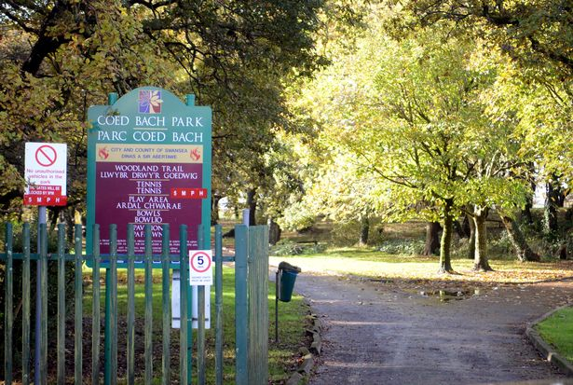
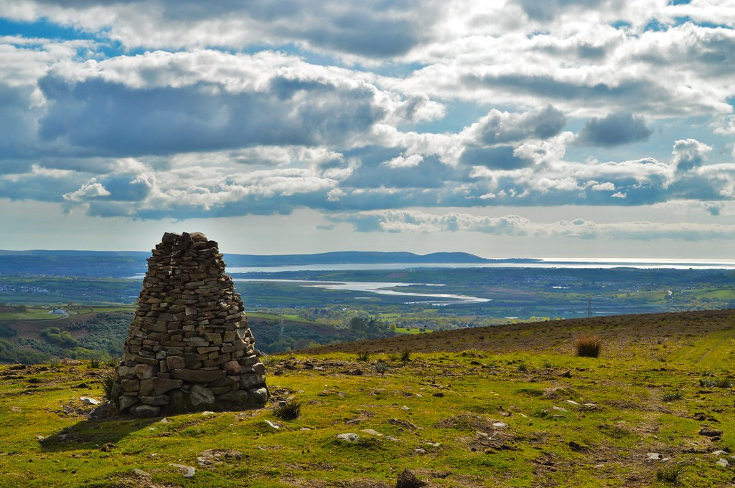
Taith Gerdded Noddedig
Bryiago Bach-
Parc Coed Bach
Bryniago Mawr-
Graig Fawr
Codi arian ? Gorffen yn y Clwb Criced –Hot Dogs etc

Slide 12
Brynia-GO-GWYRDD
Addysg Plant
Codi Arian
Dylunio Poster
Botanic Gardens
Woodland Trust
Coeden Dosbarth- i ofalu am y goeden
Cerdd Noddedig- natur o gwmpas
Gwisg Gwyrdd
Coeden dosbarth
Aigylchu Gwisg ysgol
Ailgylchu eitemau
Gwerthu ffrwyth a llysiau
Rafl-Hamperi= £1 tocyn
Taith Noddedig a gorffen yn y Clwb Criced.
Give as you live
QR Code/ ‘Donate’

Slide 13
Recycling schemes for schools
Textiles- dragonbags.co.uk
Printer cartridges- emptiesplease.com
Mobile phones- sellmymobile.com.
CDs/DVDs/games- musicmagpie.co.uk.
Batteries
IN PROGRESS
PTA+ Recycling schemes for schools

Slide 14
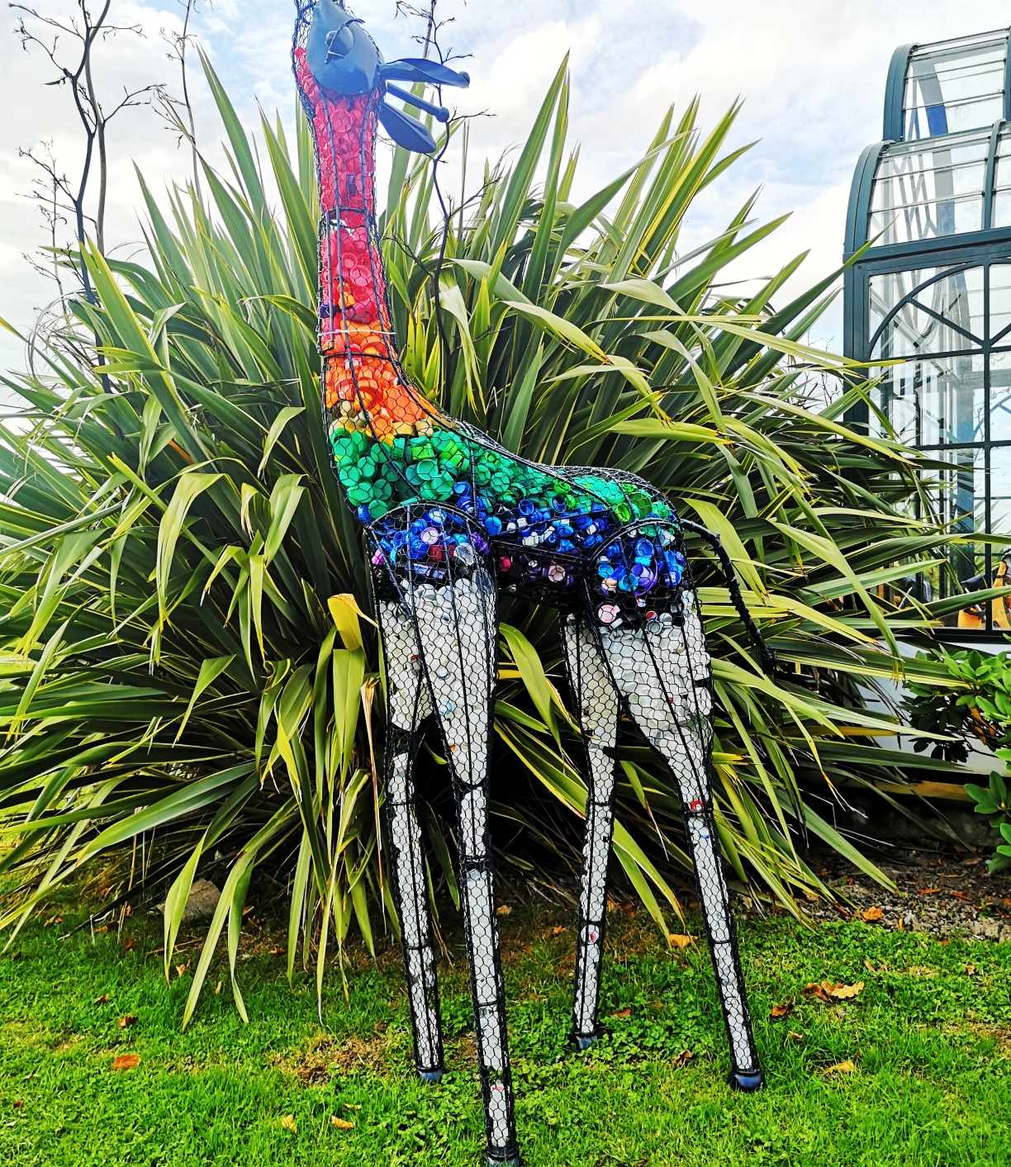

School Bottle Top Recycle Challenge
We have created six colourful giraffe sculptures, specially designed to serve as an attractive store for plastic or metal bottle tops.
School Bottle Top Recycling Challenge (britishironworkcentre.co.uk)

Slide 15

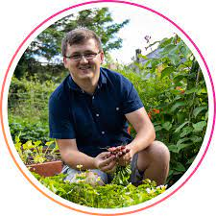
Adam yn yr Ardd
Adam Yn Yr Ardd

Slide 16
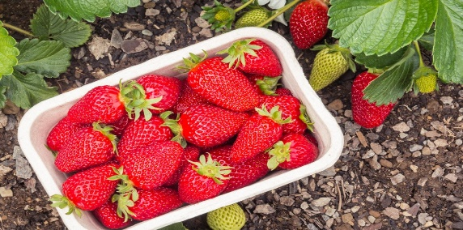
Ways to use your garden to raise funds
How your school garden can be used to raise funds
1 Crop sales:
If you get a bumper crop of produce, be it strawberries in early summer, runner beans in late summer or pumpkins for Halloween, set up a stall at the school entrance.
2 Cut flowers:
Does your school garden prioritise flowers? If so, cut them and make bunches to sell.
3 Plant sales:
If your strawberry patch is getting too big or children have grown fruit tree saplings from seed, try selling off any surplus plants.
4 Fruit juice or smoothies:
There’s nothing more refreshing on a late summer day. Make juice or smoothies and sell to parents and passers by.
5 Compost:
If your garden makes a lot of compost from food scraps and garden cuttings, bag it up and sell it. Peat-free and local!
6 Produce competitions:
Get budding gardeners to enter local contests to grow the biggest marrow, longest carrot or tallest sunflower.
7 Non-uniform gardeners:
Offer a chance for pupils to skip uniform for the day for a small fee, then come and work in the garden, raising money and learning about gardening in one go.
8 Open days and coffee mornings:
Charge a small fee or shake your donation bucket at an open day, bringing in the community to see the garden, do some pond dipping or just have a drink and a chat.
9 Treasure hunts:
Charge to open up the school garden to parents who might not have their own outside space but want to do a treasure hunt for their child’s birthday.
10 Rent a bed:
If there are parents with no outside space outside, rent a flowerbed to them.
PTA+ 10 ways to use your garden to raise funds

Slide 17

Brynia-GO-GWYRDD
Recycle unwanted clothes and raise funds for your school!
Rags 2 Riches is a free fundraising scheme that helps schools across Wales raise funds through textile recycling

Slide 18
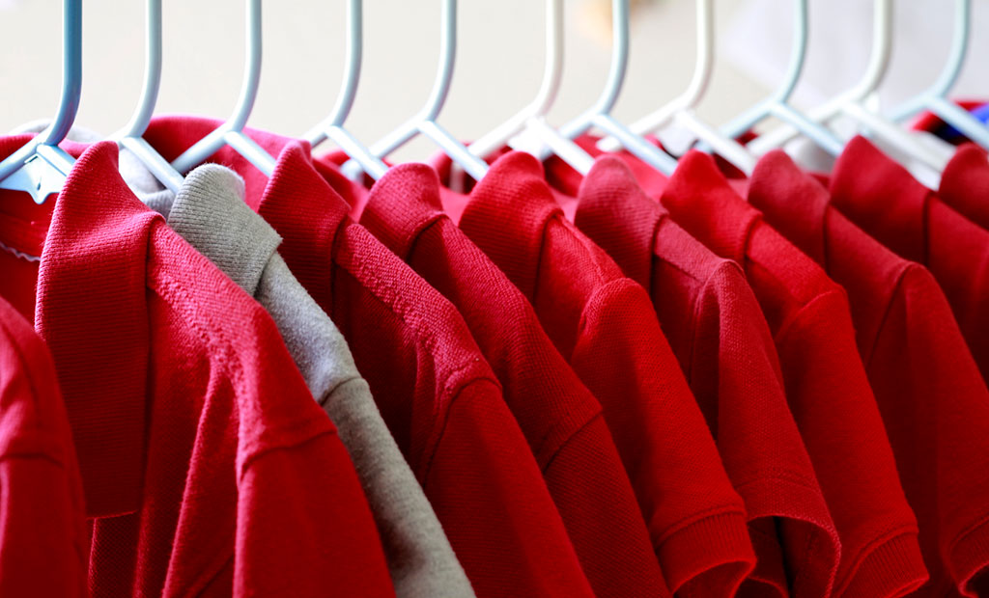
Second-hand uniform
Selling second-hand uniform can raise valuable funds, as well as reducing waste and helping those in need. Here's how to make it work for you
June

Slide 19
Busnesau lleol
Letters & leaflets to be sent to businesses
Tesco
Co op
Pontarddulais Garden Centre
Matthew Thomas Landscaping
A fwy…..

Slide 20
Brynia-GO-GWYRDD

